Slide 1
Operating system
PROJECT: Text Editor
Final Presentation

Slide 2

MEET OUR TEAM
We Selected "Simple Text Editor: Image Insertion" as our semester
Project for Operating systems.
Our Members are:
Ahmed Mehmood 211090
Shoaib Ahmad 211110
Furqan Rafique 211106

Slide 3
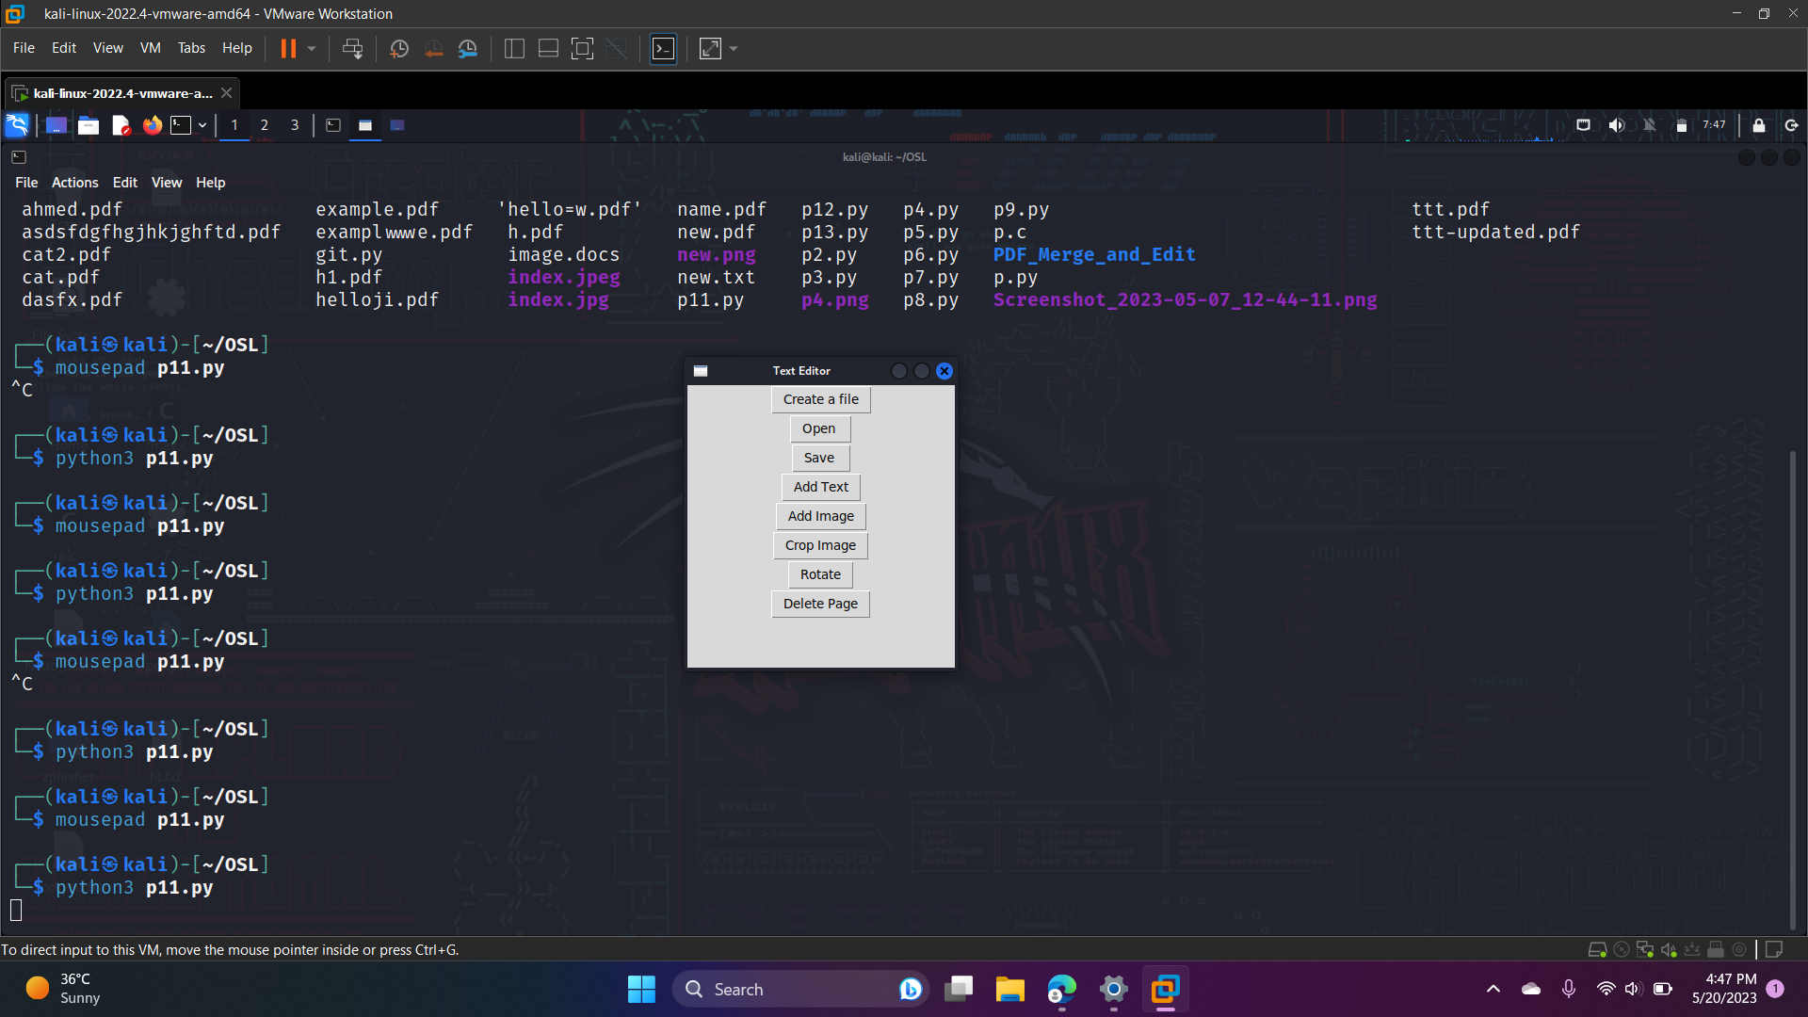
Simple text editor: GUI
The purpose of this project is to create a tool that allows users to create, edit, and save text files easily.

Slide 4
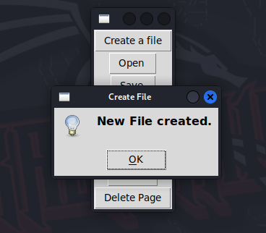
CREating file

Slide 5
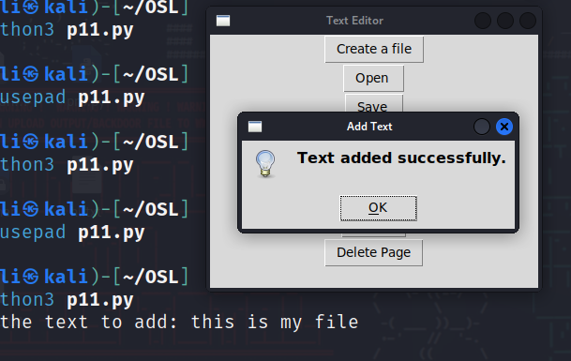
Adding text

Slide 6
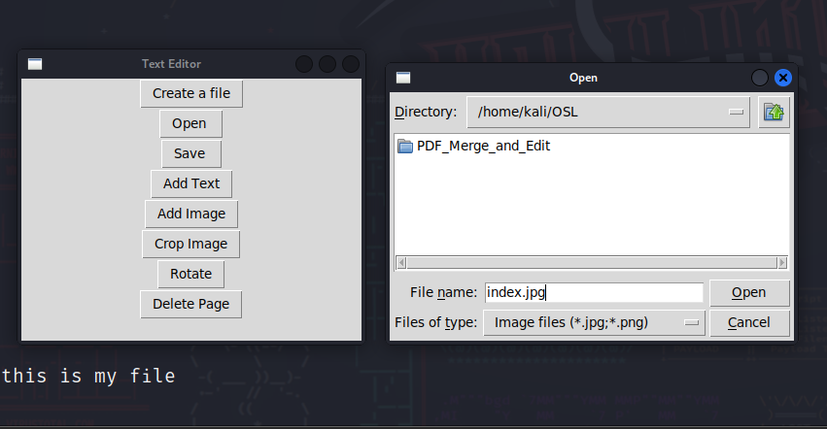

Image insertion

Slide 7


Saving file

Slide 8


Saving file

Slide 9
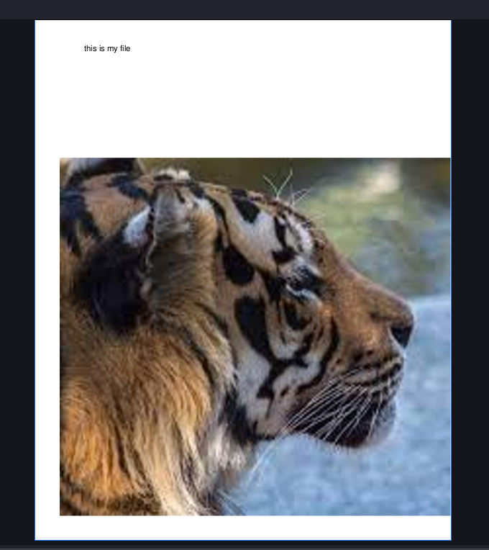
CHECKING

Slide 10
Further features

Slide 11
Requirements
Python 3.1
tkinter Library for python

Slide 12

Thank you

